Slide 1
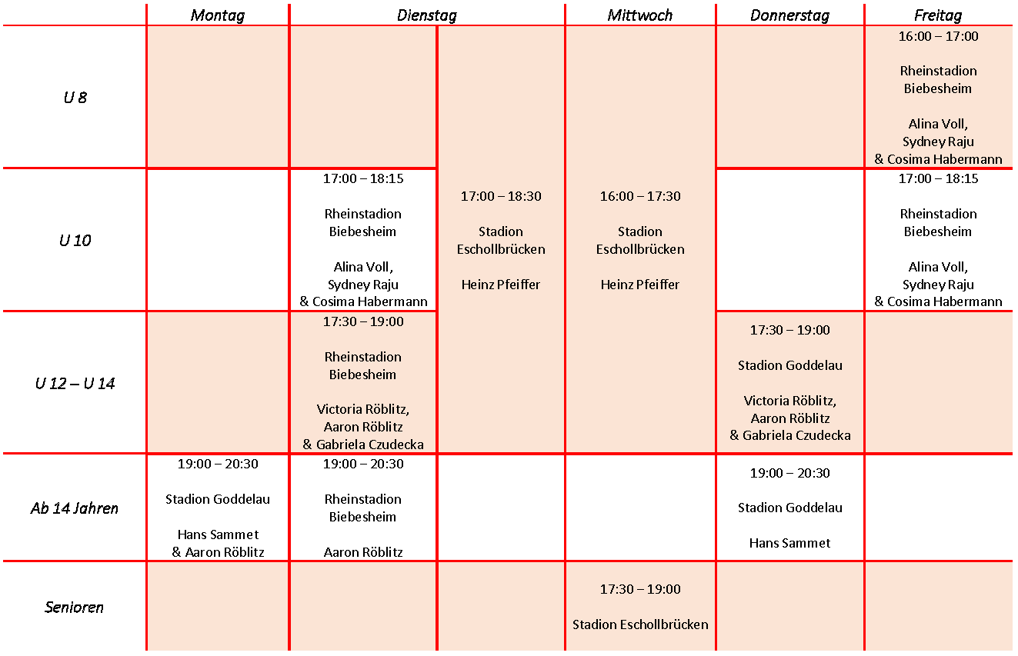
Sommertrainingsplan LG BEC 2022

